Slide 1
CS203 - PROJECT
TIC TAC TOE GAME IMPLEMENTATION USING VERILOG
PROJECT BY:
Tanish Goyal (2020CSB1133)
Vijay Dwivedi (2020CSB1140)

Slide 2
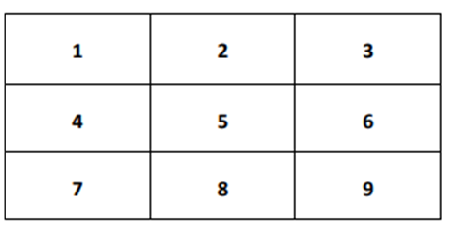

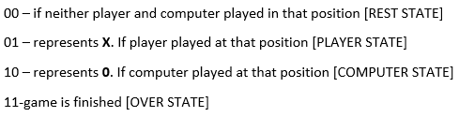
INTRODUCTION
We have implemented Tic Tac Toe in verilog using various modules.
We have used computer as the 2nd player in the game.
The player or computer wins the game if 3 similar X/0 are put in the following rows

Slide 3
DESIGN & FEATURES

Slide 4
STATES
There are 4 states in our project which are as follows :
REST state → Rest state comes when player is waiting for the computer or computer is waiting for the player to play.
PLAYER state → Player state comes when there is player’s turns to
COMPUTER state → Computer state come when there is computer’s turn to play
OVER state → Over state come when the game is finished (one of the 2 player won the match or all spaces of the tic tac toe are filled and no spaces are left to play)

Slide 5
VARIABLES
Play = 0 → Stay in the rest state
Play = 1 → switches controller to the player state and player’s turn comes
Reset = 0 → Game starts
Reset = 1 → It resets the game
Pp=1 → player to play (player’s turn)
Cp=1 → computer to play (computer’s turn)
Comp = 0 → stay in the computer state
Comp = 1 → switch to the Rest state and computer’s turn comes
Wrong_move = 0 → Player’s state will switch to the Computer’s state (if game is in player state).
Wrong_move = 1 → It means the player or computer played a wrong move which is not valid in the game this will switch to the rest state once again.
Filled = 0 → if the tic tac toe have enough space to play the next chance.
Filled = 1 → if tic tac toe does not have enough space to play (all the 9 spaces are filled and no one won the game)
Win = 0 → No one won the game till now
Win = 1 → any one player won the game and game is over and the game resets

Slide 6
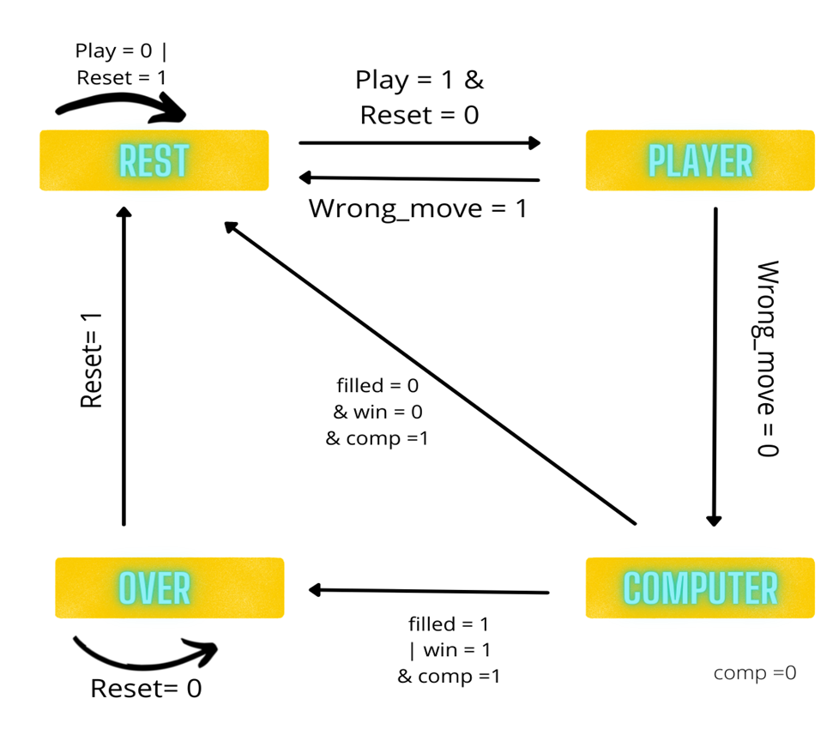
State Diagram

Slide 7
MODULES

Slide 8
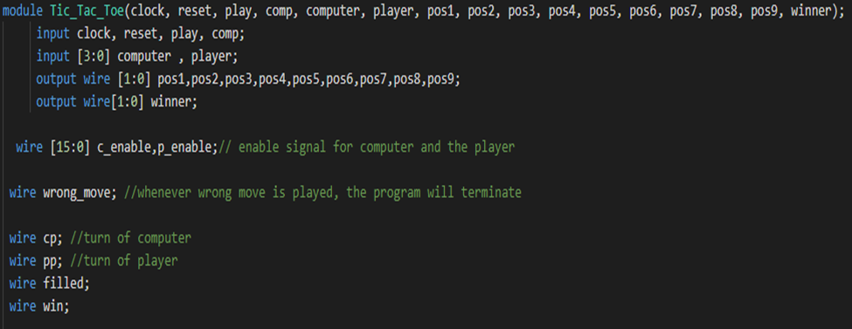
Module Tic_Tac_Toe
It’s the main module that uses all the submodules made in the code. The use of various submodules is ordered.

Slide 9
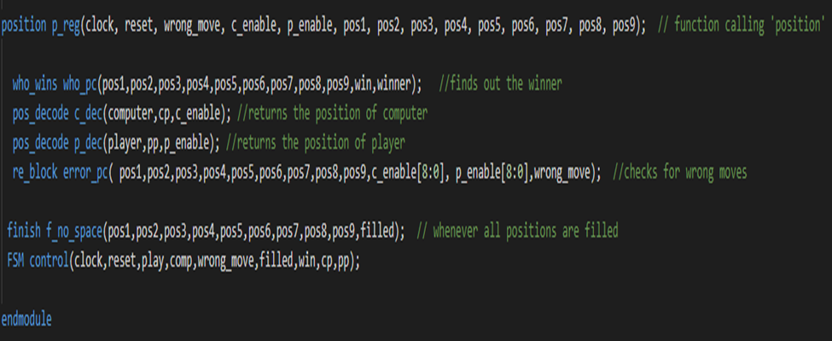
Module Tic_Tac_Toe
It’s the main module that uses all the submodules made in the code. The use of various submodules is ordered.

Slide 10
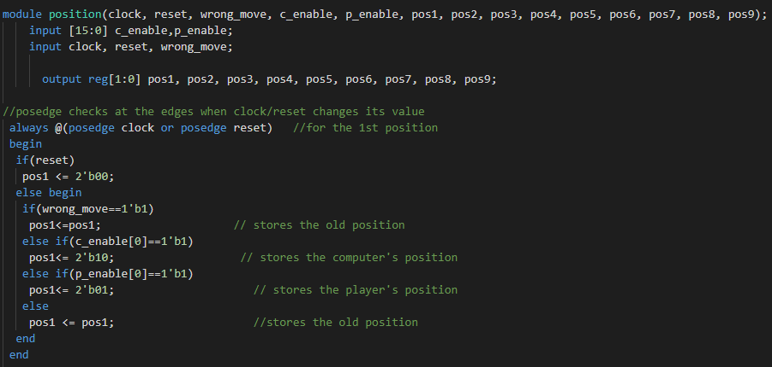
2. Module Position
This module is used to store the positions of player and computer (2nd player).
Implemented this for all the 9 positions

Slide 11
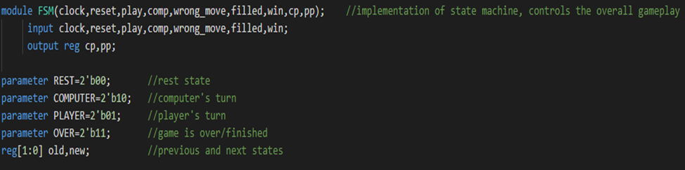
3. Module FSM
We have implemented state machine in this module.
This is the main module which is used to control the overall gameplay.
Parameter represents constant and are often used to define variable width and delay value

Slide 12
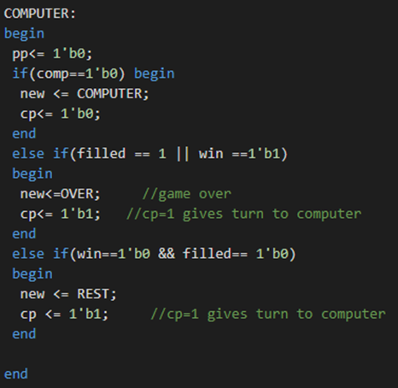
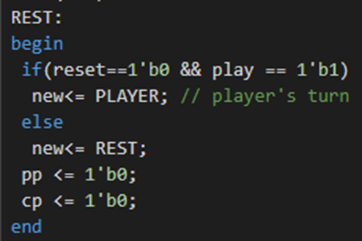
3. Module FSM
We have implemented state machine in this module.
This is the main module which is used to control the overall gameplay.

Slide 13
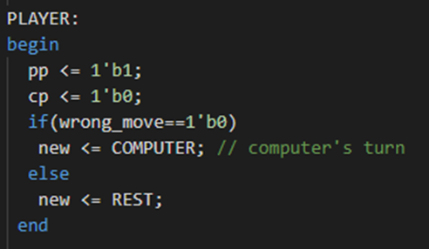
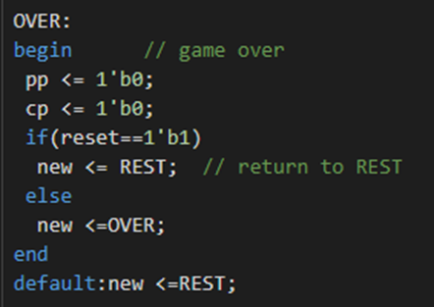
3. Module FSM
We have implemented state machine in this module.
This is the main module which is used to control the overall gameplay.

Slide 14
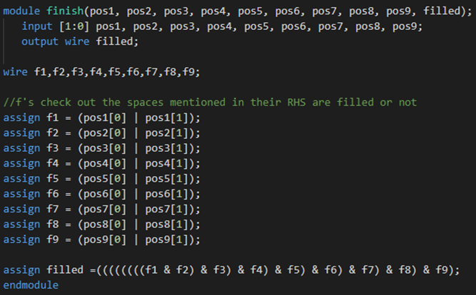
4. Module Finish
This module is used to detect if all 9 positions are filled and no one won the game.
f(i) = 1 → i th position is filled
When all 9 positions are filled
Filled = 1

Slide 15
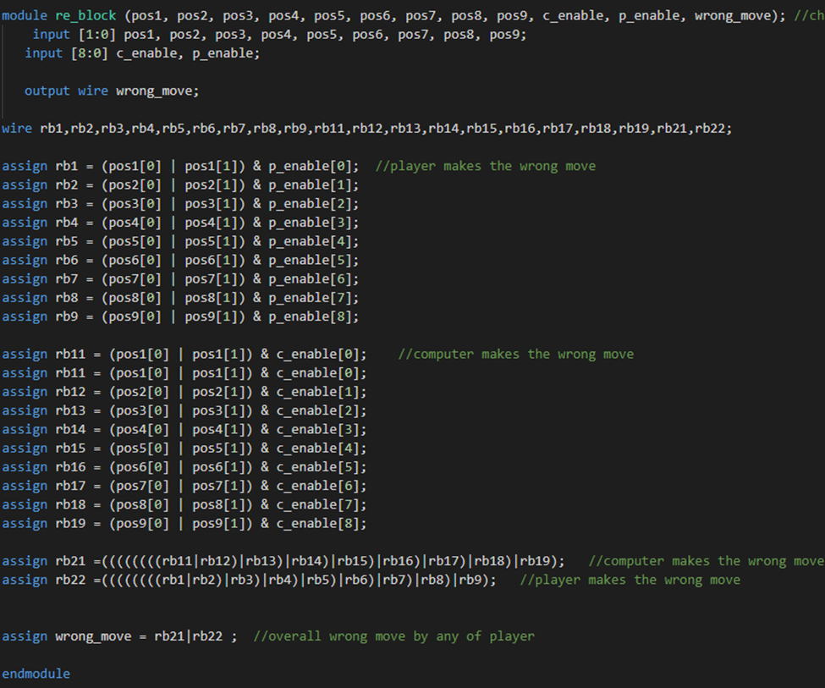
5. Module Re_block
This module is used to check whether the player or computer played a wrong move or not.
for(i>=1 && i<=9)
If rb(i) = 1 → rb22 = 1
Implies Player played a wrong move
for(i>=11 && i<=19)
If rb(i) = 1 → rb21 = 1
Implies computer played a wrong move

Slide 16
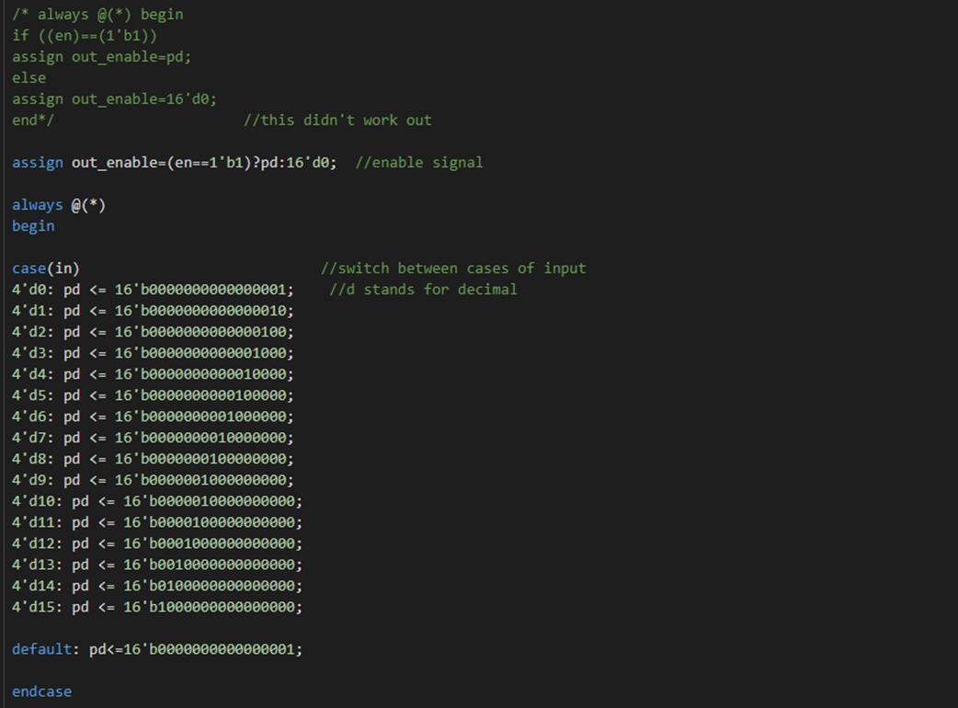
6. Module Pos_decode
It decodes the position of player and computer at all points in a game.it is 4 to 16 bit decoder.

Slide 17
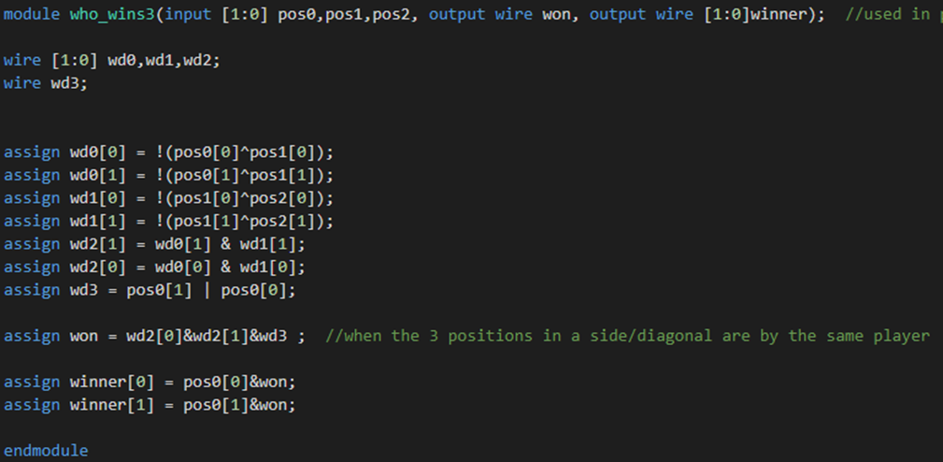
7. Module Who_wins3
In this module, we check if 3 positions (of a side or diagonal) is filled first by the same player.
Output Winner is the winner of game.

Slide 18
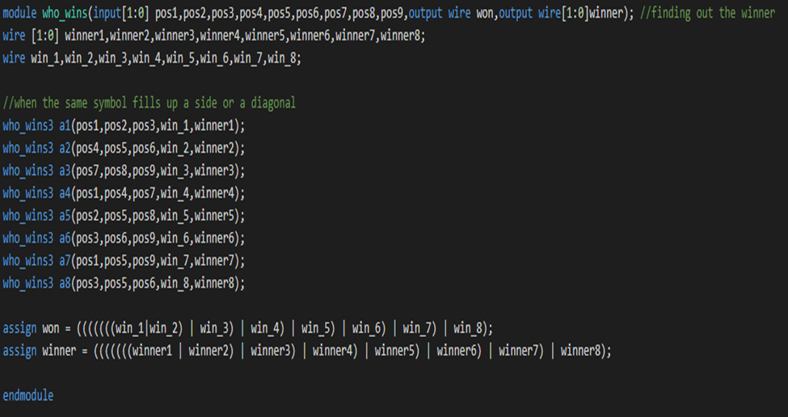
8. Module Who_wins
This module checks the three rows, three columns and two diagonals are filled by the same player. It does so by repeatedly calling “who_wins3”. It keeps a check if any of them has won the match or not.

Slide 19
RESULTS

Slide 20
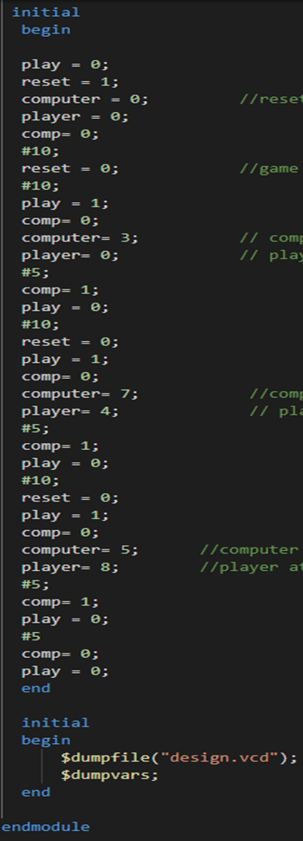
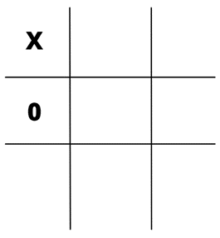
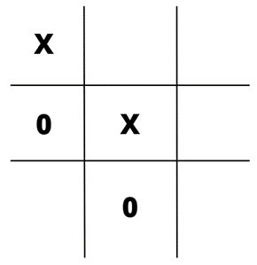
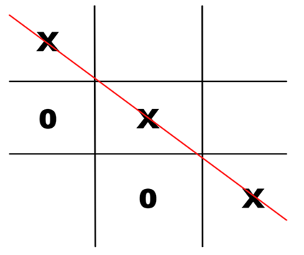
Test_Bench
Game starts
Player → 1
Computer → 4
Player → 5
Computer → 8
Player → 9
Computer → 6

Slide 21
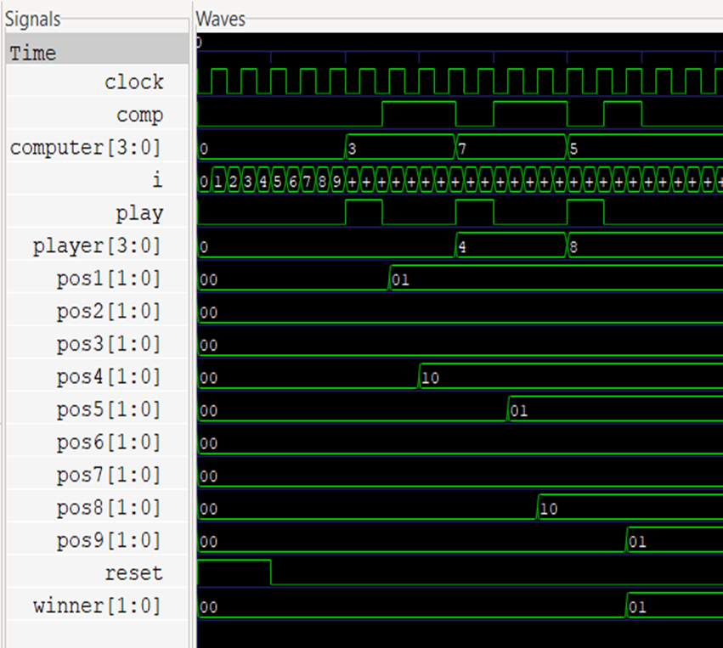
EP_Wave

Slide 22
WE THANK NEERAJ SIR FOR GIVING US THIS OPPORTUNITY TO WORK AND COLLABORATE ON PROJECT.

